Slide 1


Terraform plugin programming is easy
Fortunate
you

Slide 2
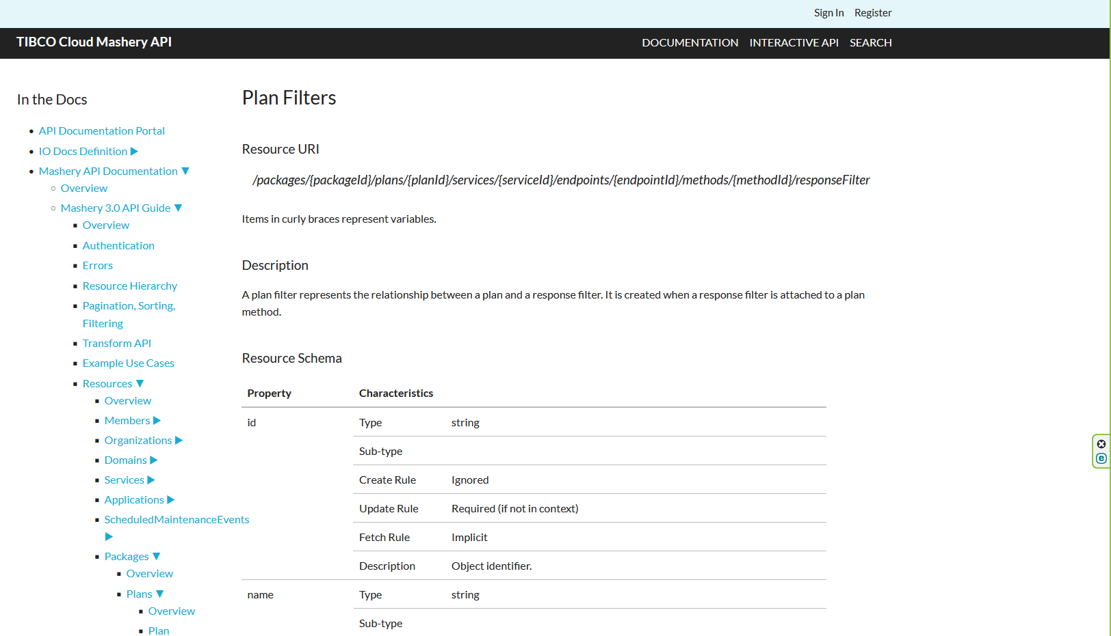
SDKv2 Operations | Passing data clumps
①
②
③
④
⑤

Slide 3
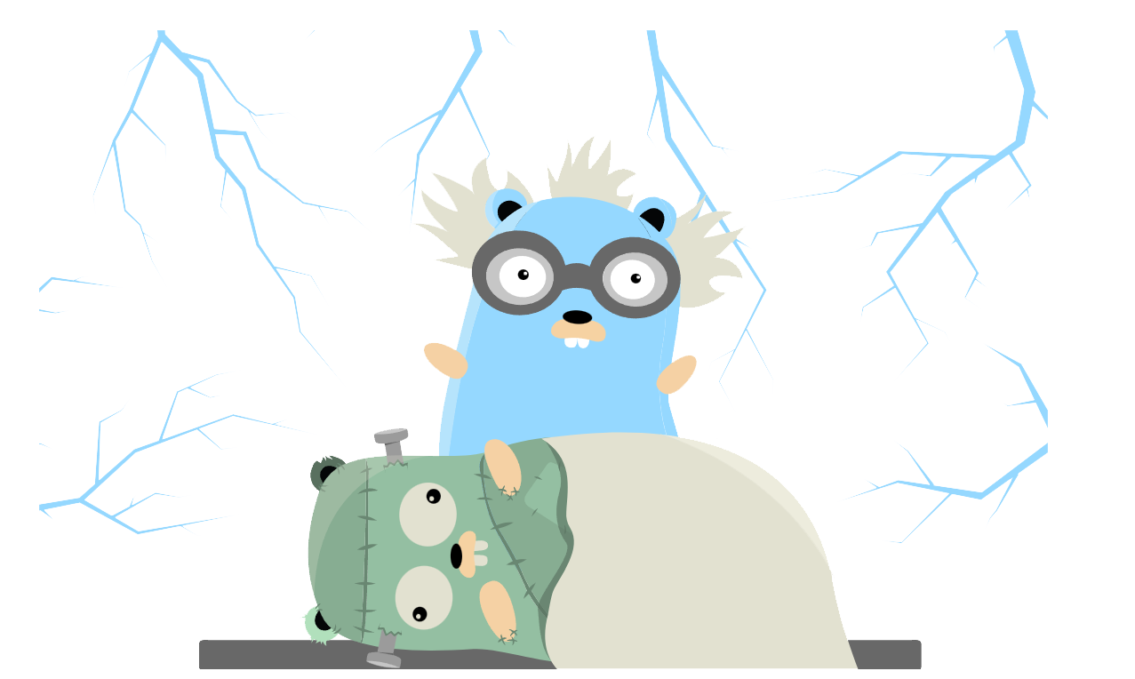
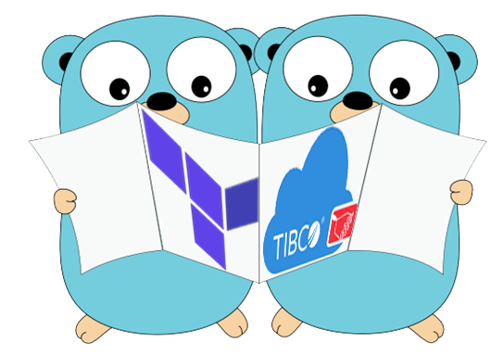
My practical problems from the field

Slide 4
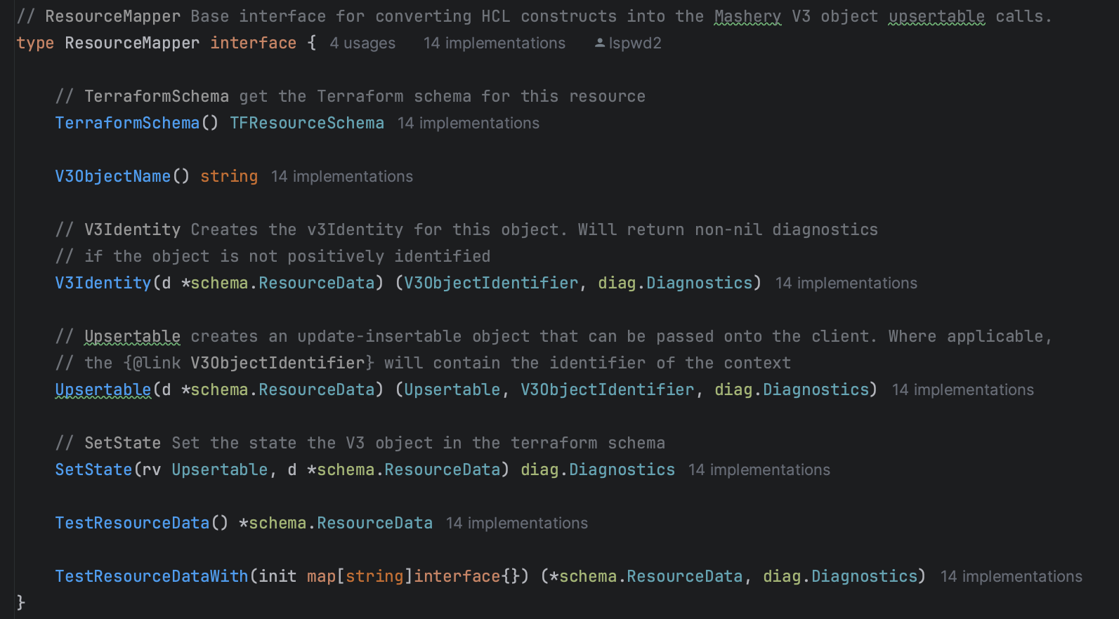

My practical problems from the field
interface{}
Ninja Powerrrrrr!
Notes:
Dilemma:
- create resource-specific interface for each resource type?
- write a reusable code and deal with weak typing somehow?
Doing in my own (very scarce) free time
Variations added over time
Yes, monkey patching!
Eventually implementation creep
Lots of repetitive code, hard to maintain
Don’t ask be about testing
Fails when you need it

Slide 5
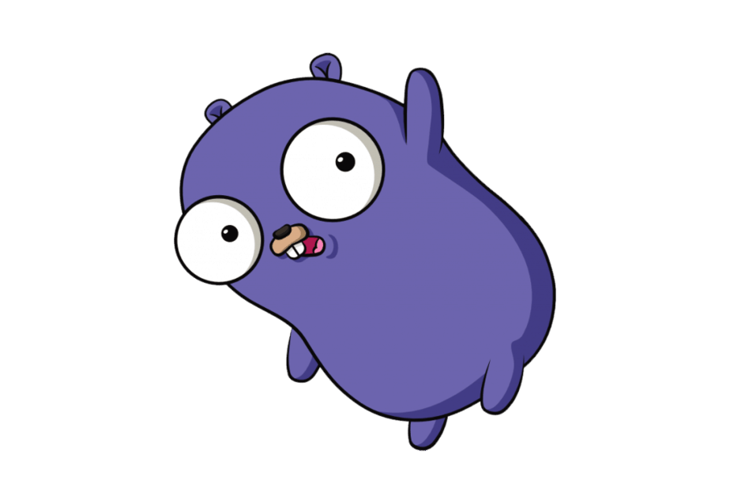

Terraform plugin programming is easy
[T]
to the rescue!
Excited
me

Slide 6
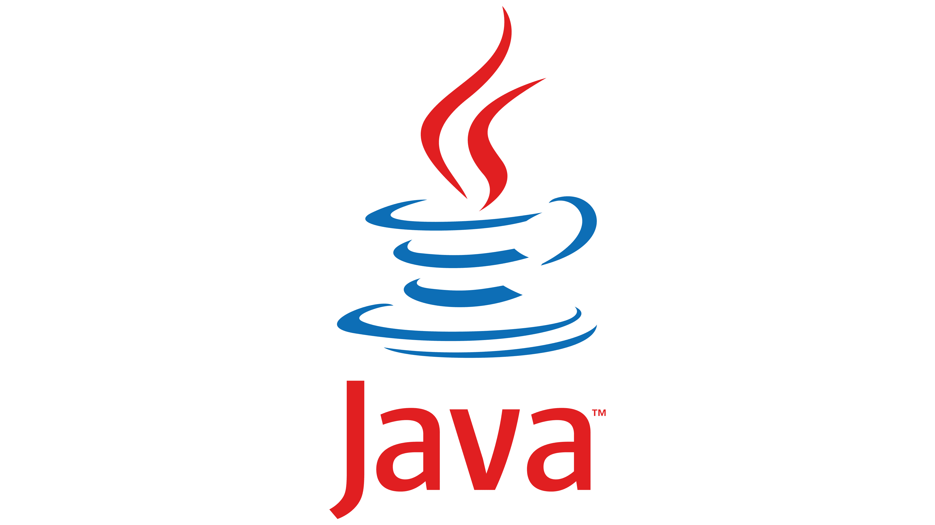
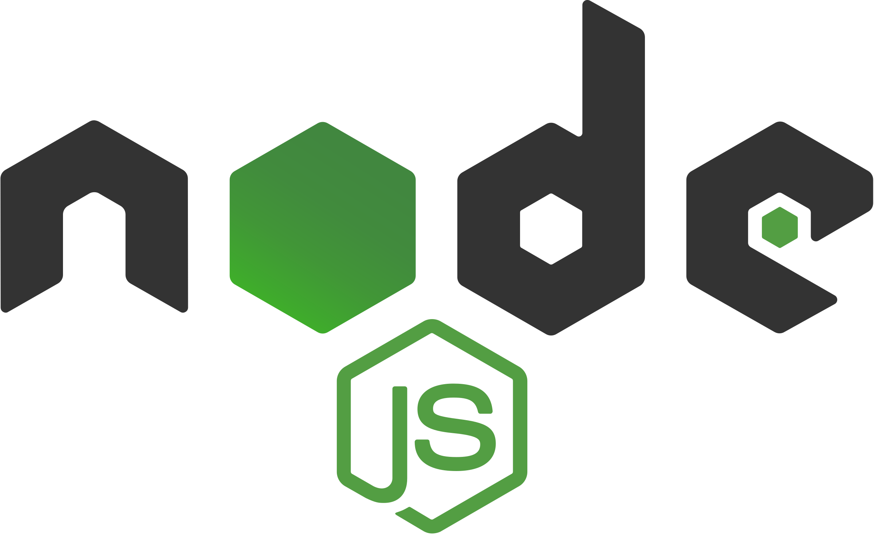



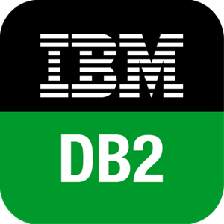

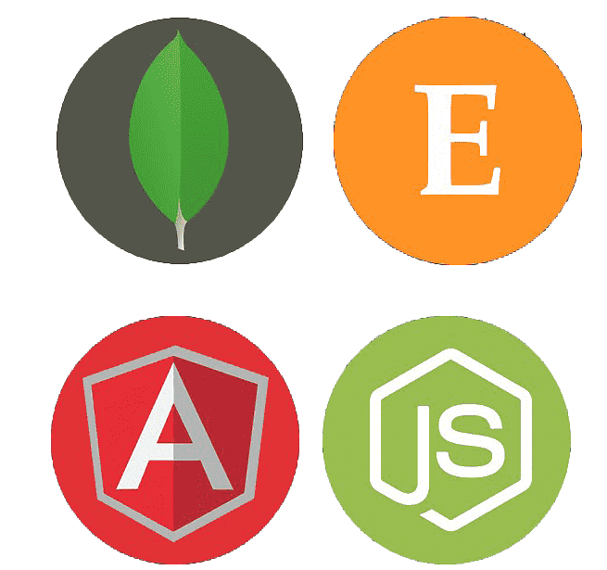
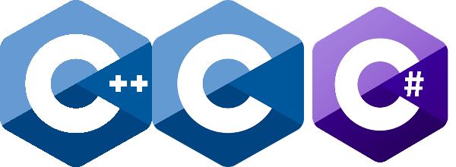
Awesome to have you here!

Slide 7

Generics Let Generics

Slide 8
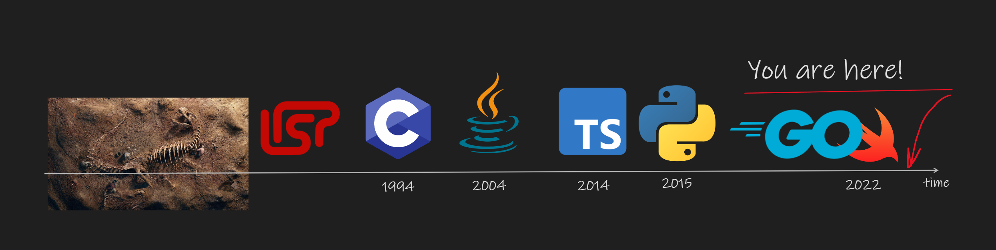
New to generics?
Notes:
30 years ”young” concept
C++ had it as back as in 1994. It’s almost 30 years ago
Introduced in Java since 2004. Almost 20 years back
Other langauges opted for duck typing (e.g. Ruby)
Golang introduced in version 1.18 (March 2022)
Swift introduced same year at WWDC22, in version 5.7 (2022)

Slide 9
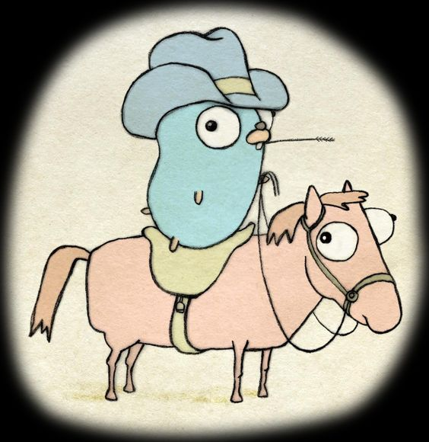

There’s nothing fundamentally wrong with interface{}
Notes:
Emphasize that it is all about trade-offs between various concerns.
All problemes shown here can be solved differently, including not using generics in the first place

Slide 10
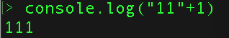
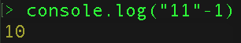
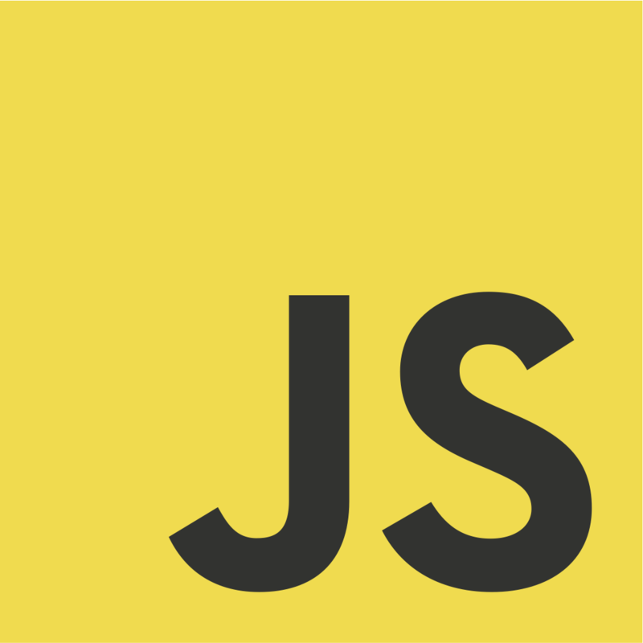
Which very popular language doesn’t use generics and is totally fine?

Slide 11
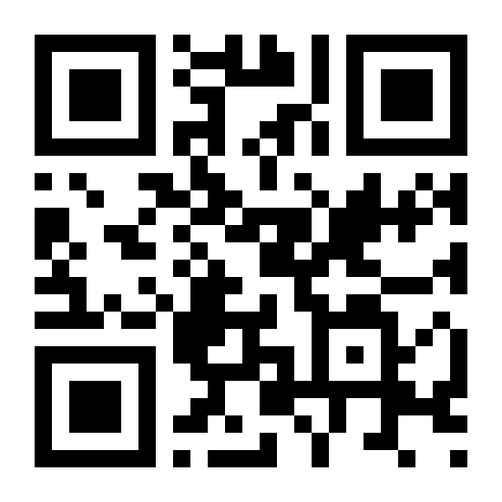
http://etc.ch/kQS6

Slide 12
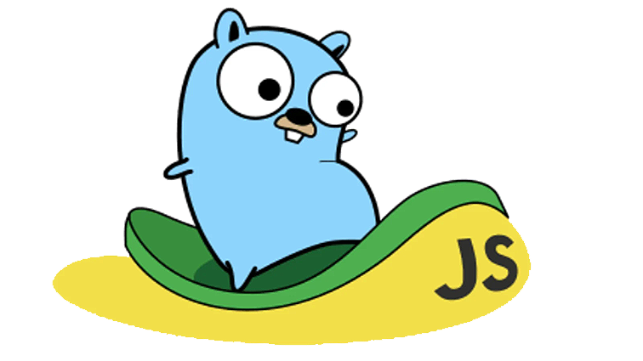

There’re lots to improve on interface{}

Slide 13
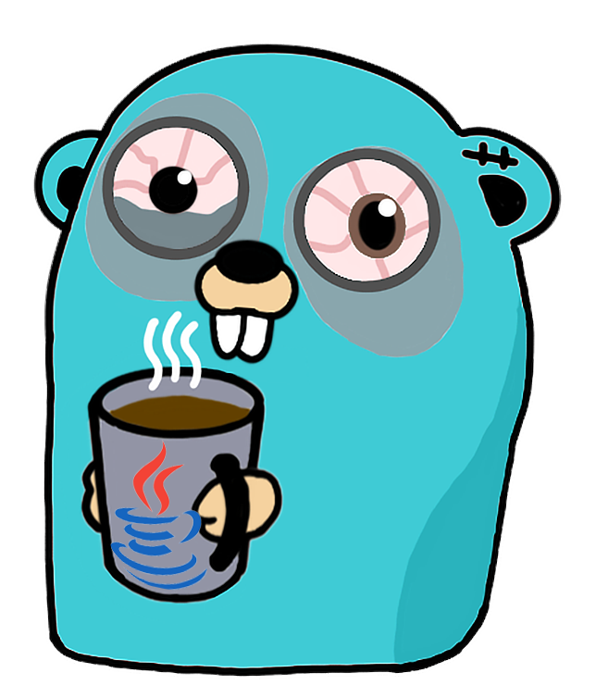

dev meets generics
Notes:
Programming is all about making trade-offs
All code samples I can show you could be written in many different ways

Slide 14

The Generification Workflow
Model concrete types
Identify common capabilities
Build an interface
Write generic code / refactor into generified code

Slide 15
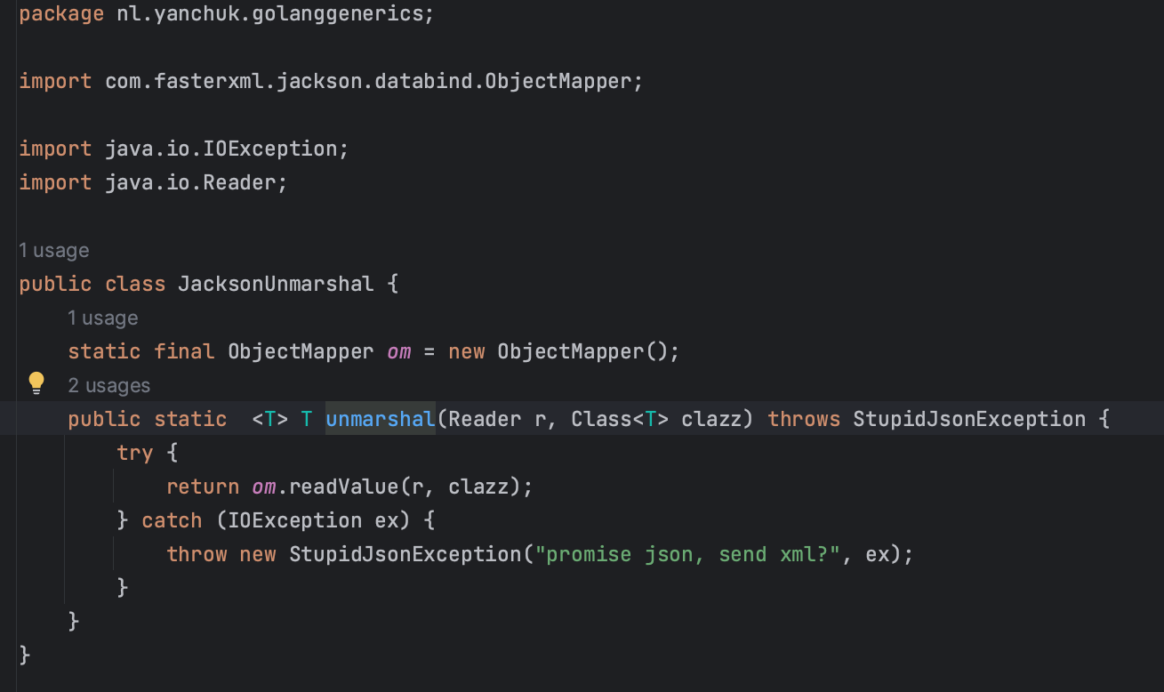

Slide 16
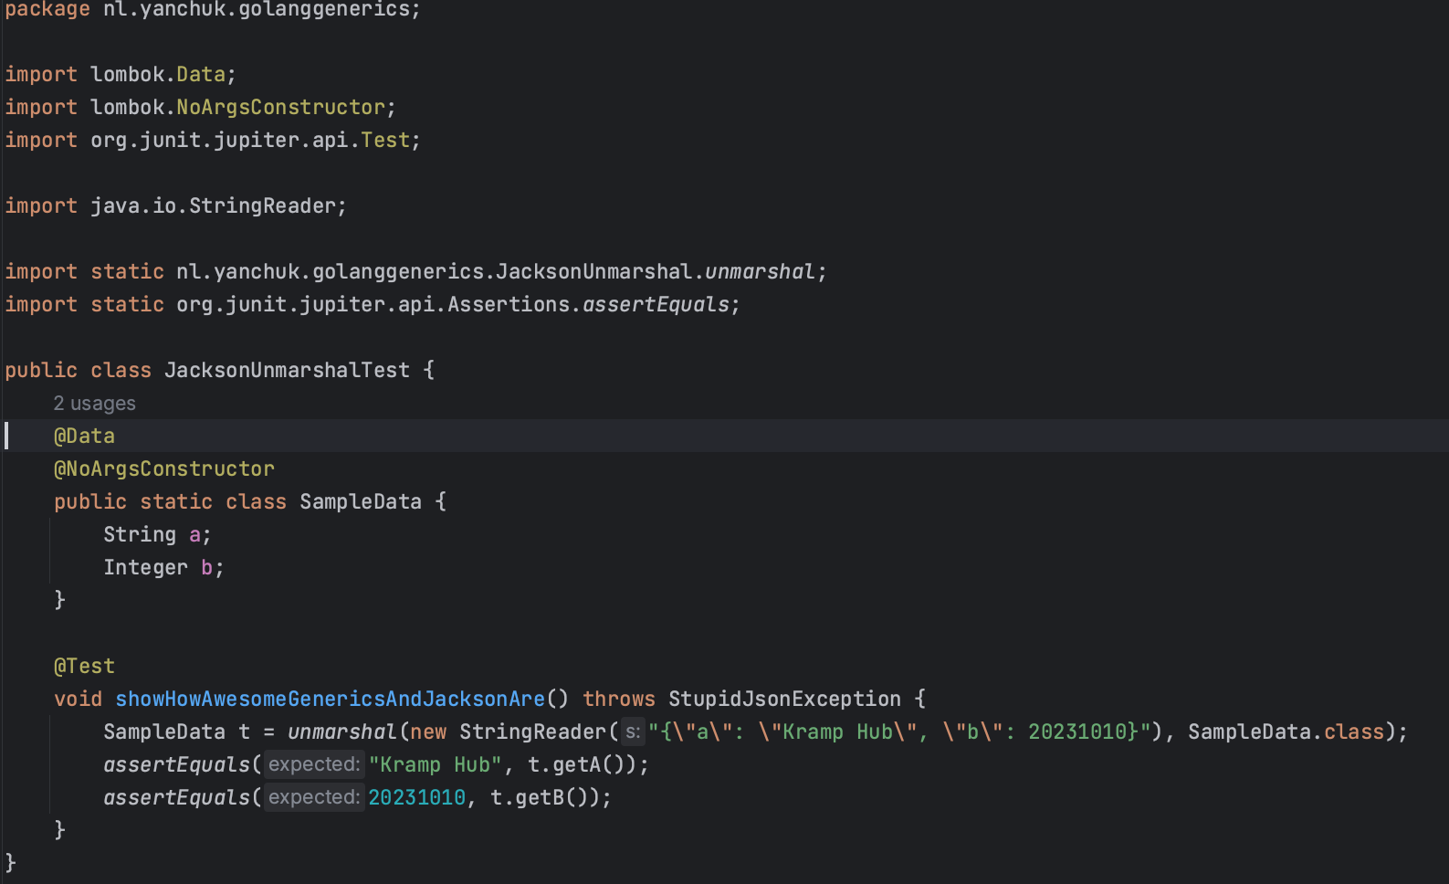

Slide 17
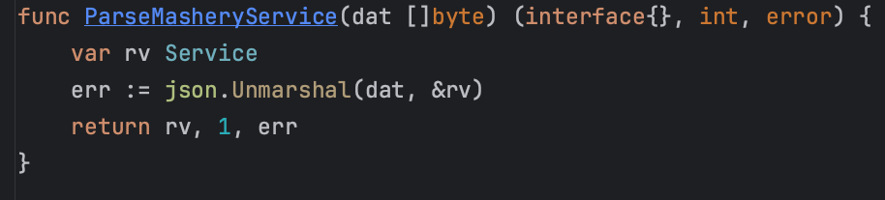
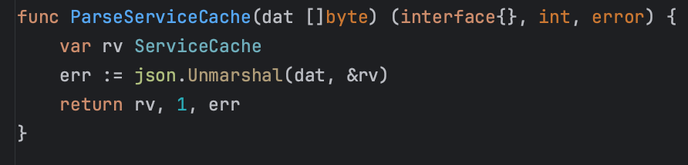

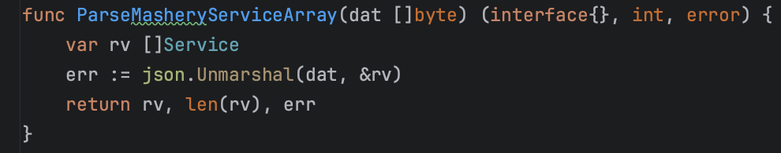
XDoclet would have been nice

Slide 18
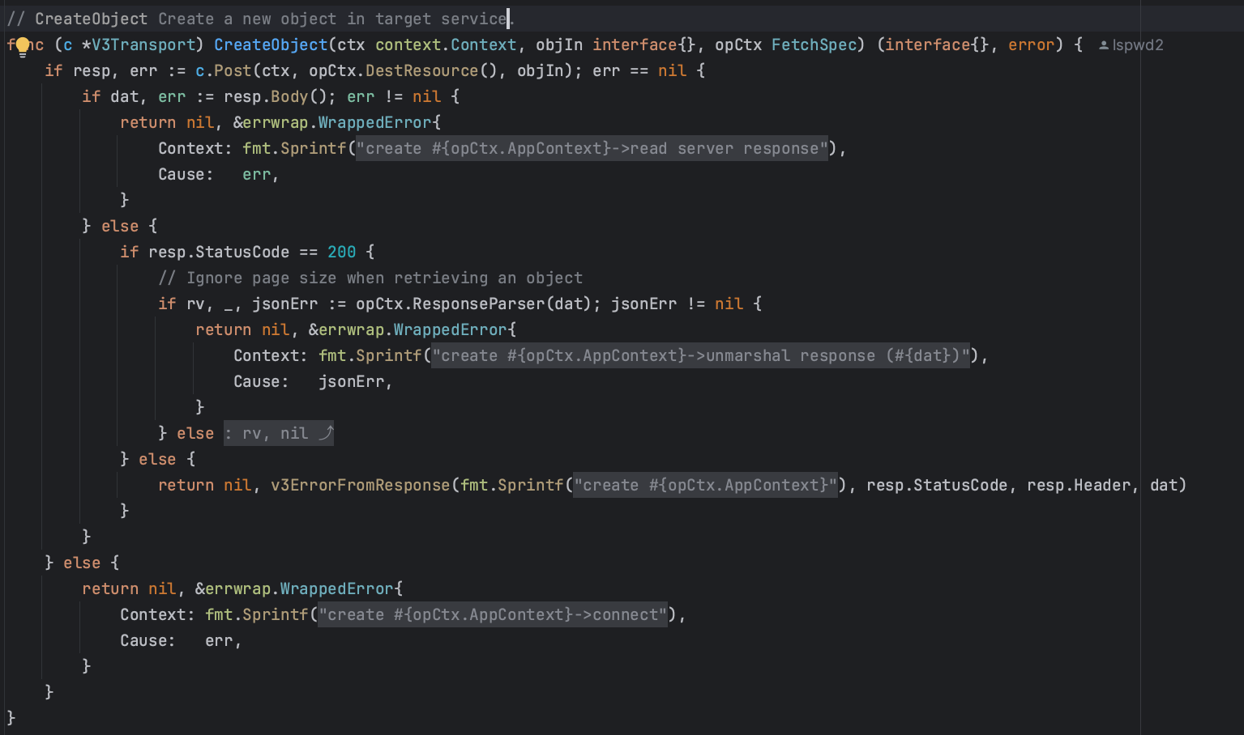

Slide 19
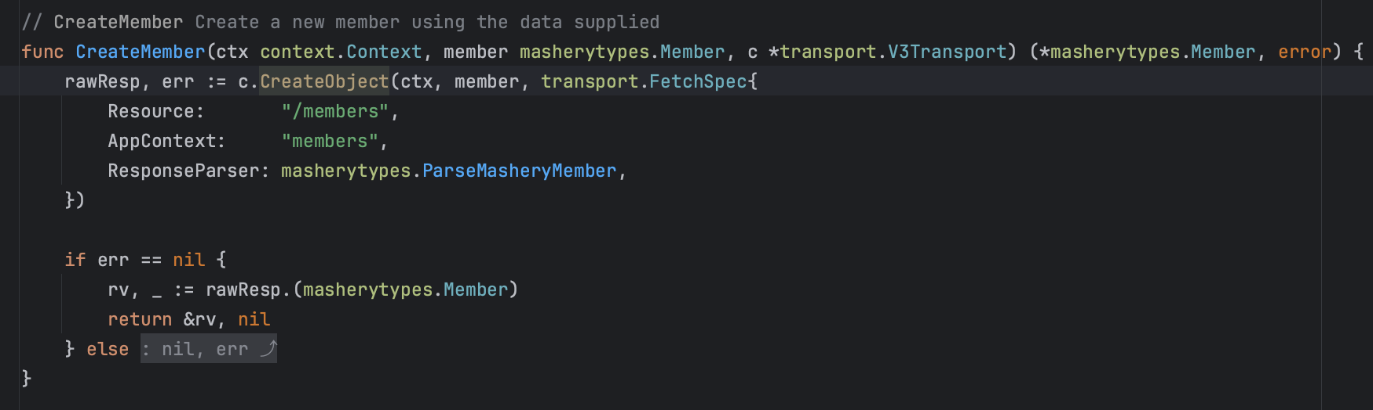

Slide 20

Polymorphism
Method overloads achieve ad-hoc polymorphism
Subtypes achieve subtype polymorphism
Generics achieve parameter polymorphism
Notes:
Generics define a common piece of code that works for all applicable types; and the types themselves are the parameter.

Slide 21
List<T>

Slide 22
No generics in code = you work for the compiler

Slide 23
Generics in code = compiler works for you

Slide 24

Generics: 3rd polymorphism type
So this is how these would creep into your code
Notes:
Rational use case for generics
Type safety!
Abstraction to separate ideas and algorithms from details and data
Express dependencies that need different input for similar operations
Rational objections to Generics in Go
Binary execution can become slower
Dependencies can be fixed by adding (boilerplate) code
The use of interface{} is still allowed
Unexpected binary bloat

Slide 25
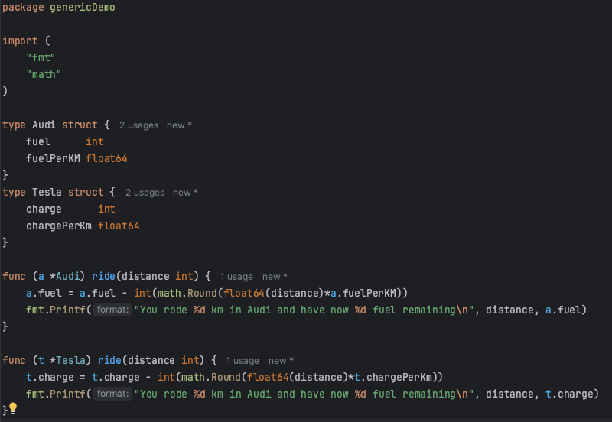
Notes:
Introduce two types

Slide 26
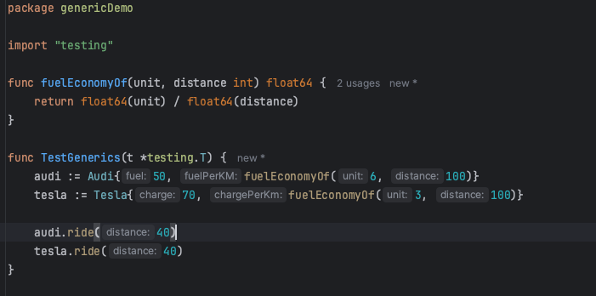
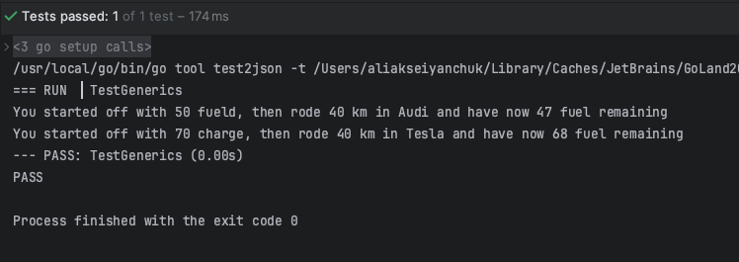
Notes:
Create a first unit test

Slide 27
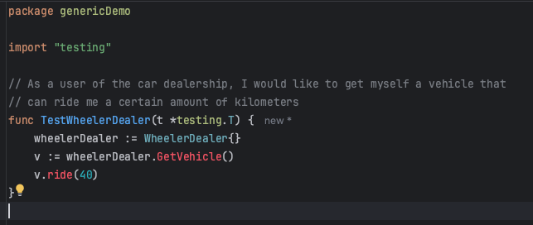
Notes:
Create a requirement that can be solved using factory and interface

Slide 28
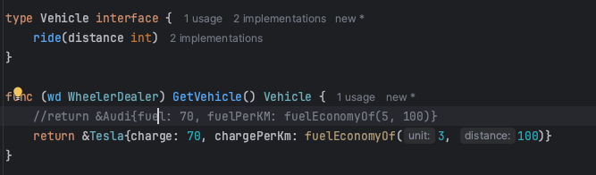
Notes:
Need to change this to Audi for the better demonstration

Slide 29
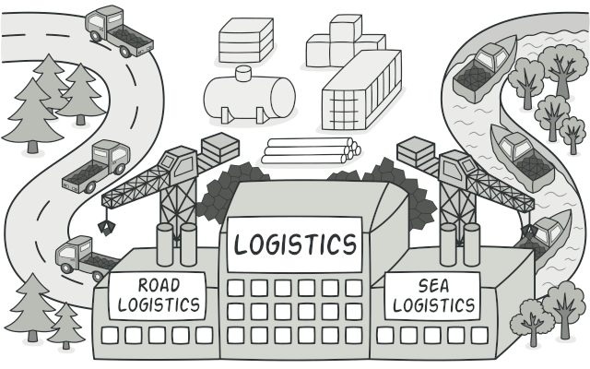
Sourcel https://refactoring.guru/design-patterns/factory-method

Slide 30
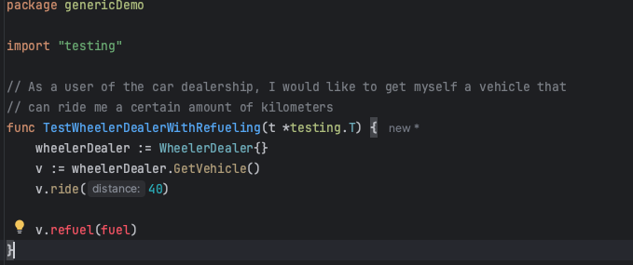

Slide 31
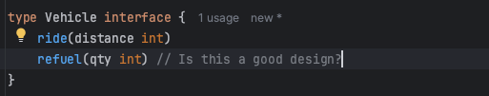
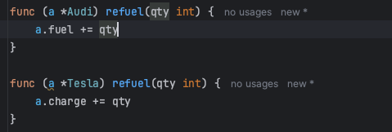
Notes:
Is this a good design? Provoke discussion about a domain-driven design issues, leading to some serious bugs.

Slide 32
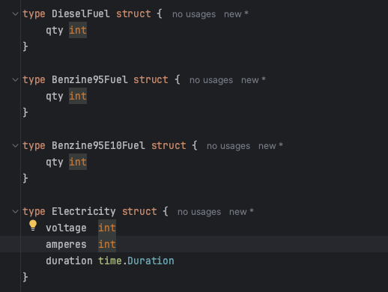

Slide 33
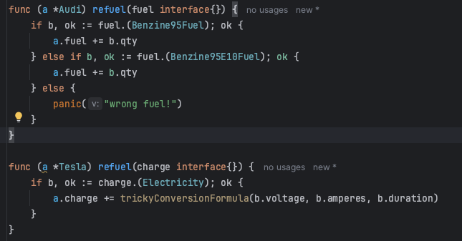

Slide 34
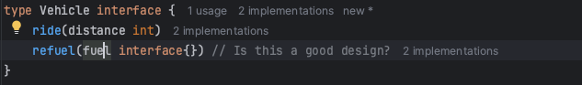
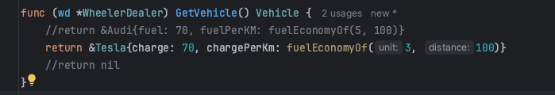
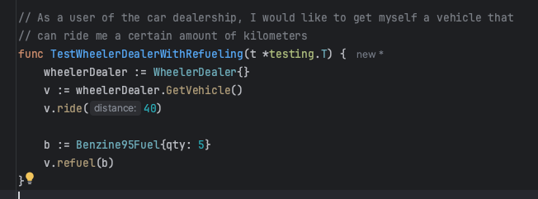

Slide 35

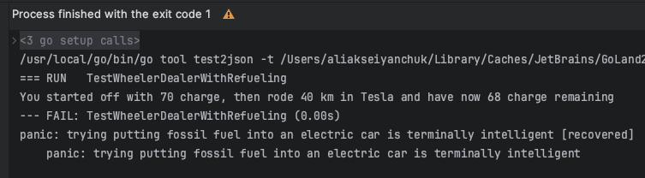
Generics!!!! Or No Go!

Slide 36
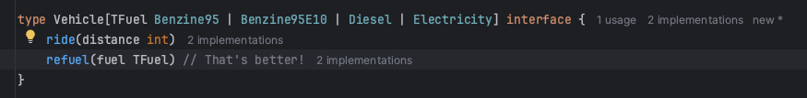
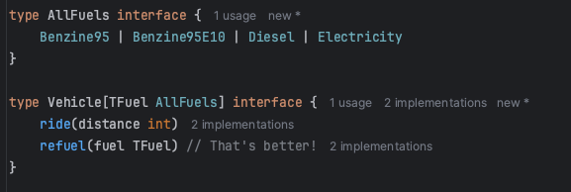

Slide 37
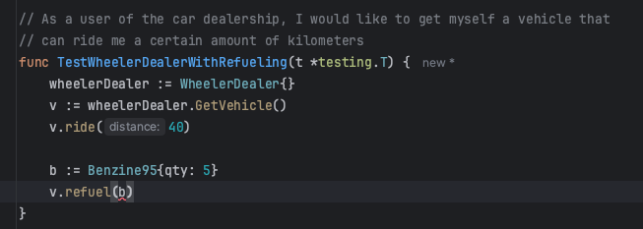

Slide 38

Writing crashing code has come (a bit) harder

Slide 39
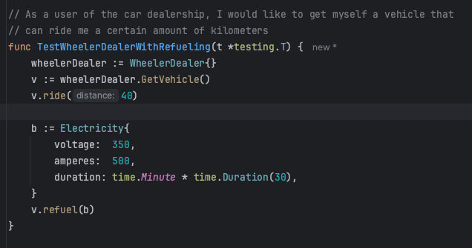

Slide 40
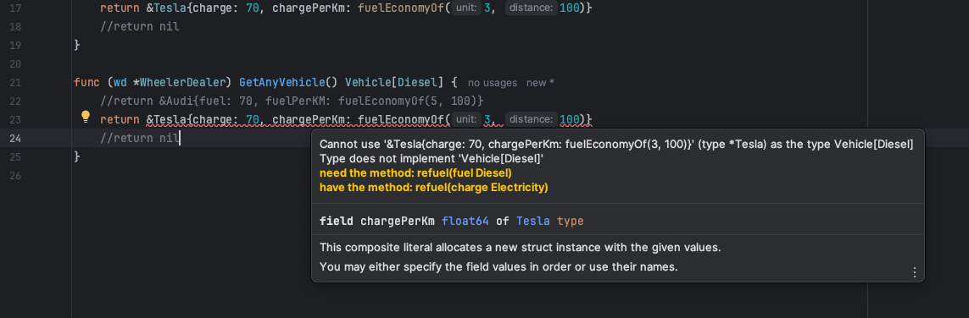
Notes:
Now the fuel is pushed to the top-level interface, even where it would not be required
Unfortunately this this something that language has to support.
Reference to Swift 5.7 association types

Slide 41
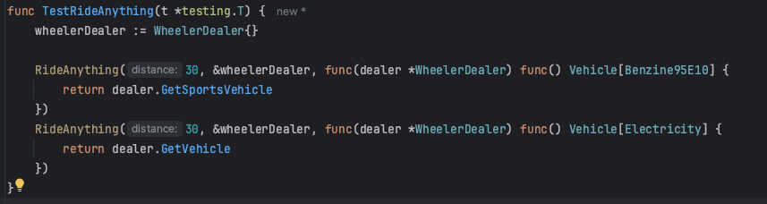
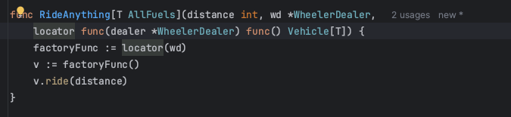
Notes:
Generics come hand-in-hand with functional programming. This is example of Lambda expressions.

Slide 42
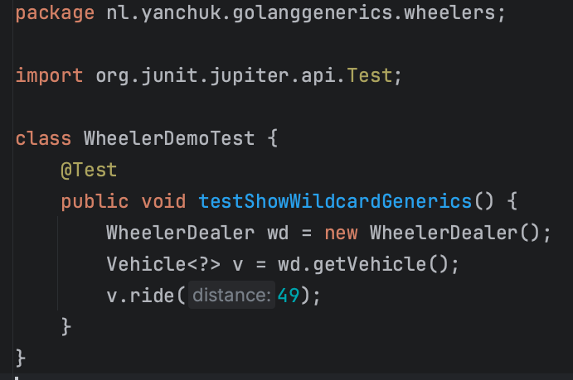
Notes:
Wildcard generics are not possible in Golang.

Slide 43

This design cannot, probably, be generified

Slide 44
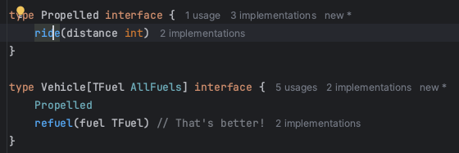
Notes:
Example of interface refactoring

Slide 45
Associative generic types

Slide 46

Introducing Generics into existing codebase

Slide 47
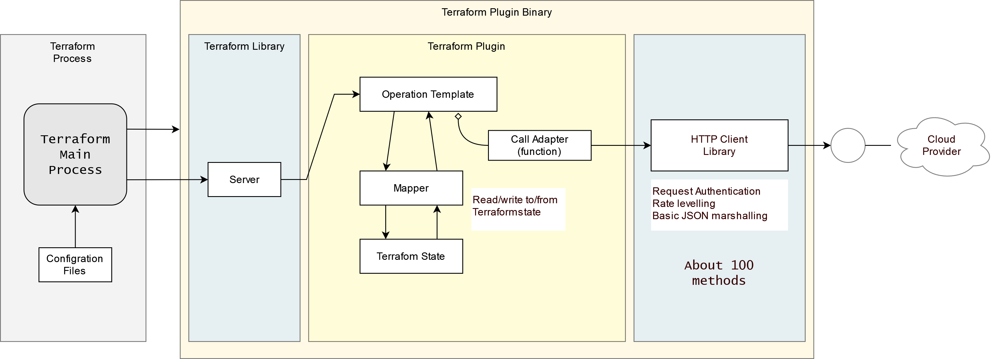
Go 1.15 architecture

Slide 48


Slide 49


Slide 50


Slide 51

It almost didn’t change It’s simple It’s just a bit verbose
Vvvvvverbose

Slide 52

Bloat example
1

Slide 53

Bloat example
2

Slide 54

Bloat example
3

Slide 55

Take-out
It takes much, much deeper refactoring than I thought!...
Notes:
Golang function purity

Slide 56

7 Reasons to Let go Generics

Slide 57

You like type-unsafe code

Slide 58

Writing is rewriting. Coding is re-coding

Slide 59

Your tech lead has told you to clean your code

Slide 60

You are convinced that functional programming is a fad

Slide 61

You don’t test your code (automatically)
Notes:
Or when you, you do it in production

Slide 62

The worse the code, the higher the job security

Slide 63

There’s always something generics can’t do

Slide 64

We don’t do Java here!
Nr. 8

Slide 65

List<T>
Brains!..

Slide 66

Happy Generifying!
Aleks Yanchuk

